Slide 1

COMPUTER NETWORKS
S Nagasundari
Department of Computer Science and Engineering

Slide 2

COMPUTER NETWORKS
Unit – 5 Link Layer and LAN Roadmap
Introduction
Error detection, correction
Multiple access protocols
LANs
addressing, ARP
Ethernet
switches
A day in the life of a web request
Physical layer
Wireless LANs: IEEE 802.11

Slide 3
COMPUTER NETWORKS
Class 48 : Multiple Access Protocols : Learning Objectives
Multiple Access
Carrier Sense Multiple Access/Collision Detection

Slide 4









COMPUTER NETWORKS
Multiple access links protocols
shared wire (e.g.,
cabled Ethernet)
shared radio: 4G/5G
shared radio: WiFi
shared radio: satellite
humans at a cocktail party
(shared air, acoustical)
Two types of “links”:
point-to-point
point-to-point link between Ethernet switch, host
PPP for dial-up access
broadcast (shared wire or medium)
old-fashioned Ethernet
upstream HFC in cable-based access network
802.11 wireless LAN, 4G/4G. satellite

Slide 5
COMPUTER NETWORKS
Multiple access problem
How to coordinate the access of multiple sending and receiving nodes to a shared broadcast channel
Broadcast channels are often used in
LANs,
Networks that are geographically concentrated in a single building (or on a corporate or university campus).
Can I say Television as an example for Broadcasting??
Traditional television-one-way broadcast
While nodes on a computer network- broadcast channel can both send and receive

Slide 6
COMPUTER NETWORKS
Human Protocols for sharing Broadcast channel
Give everyone a chance to speak.
Don’t speak until you are spoken to.
Don’t monopolize the conversation.
Raise your hand if you have a question.
Don’t interrupt when someone is speaking.
Don’t fall asleep when someone is talking

Slide 7
COMPUTER NETWORKS
Multiple access protocols
Single shared broadcast channel
Two or more simultaneous transmissions by nodes: interference
collision if node receives two or more signals at the same time
When multiple nodes are active in Broadcast channel,
coordinate the transmissions of the active nodes.
Multiple access protocol
Distributed algorithm that determines how nodes share channel, i.e., determine when node can transmit
Communication about channel sharing must use channel itself!
no out-of-band channel for coordination

Slide 8
COMPUTER NETWORKS
An ideal Multiple access protocol
Given: Multiple access channel (MAC) of rate R bps
Desirable characteristics:
1. when one node wants to transmit, it can send at rate R.
2. when M nodes want to transmit, each can send at average rate R/M
3. Fully decentralized:
no special node to coordinate transmissions
no synchronization of clocks, slots
4. simple

Slide 9
COMPUTER NETWORKS
MAC protocols : Taxonomy
Three broad classes:
Channel partitioning
divide channel into smaller “pieces” (time slots, frequency, code)
allocate piece to node for exclusive use
Eg: TDM,FDM,CDMA
Random access
channel not divided, allow collisions
“recover” from collisions
Eg. ALOHA,CSMA deployed in Ethernet
“Taking turns”
nodes take turns, but nodes with more to send can take longer turns

Slide 10
COMPUTER NETWORKS
CSMA ( Carrier Sense Multiple Access)
Simple CSMA: listen before transmit:(Carrier Sensing)
if channel sensed idle: transmit entire frame
if channel sensed busy: defer transmission
Human analogy: don’t interrupt others!
CSMA/CD: CSMA with collision detection
collisions detected within short time
colliding transmissions aborted, reducing channel wastage
collision detection easy in wired, difficult with wireless
human analogy: the polite conversationalist

Slide 11
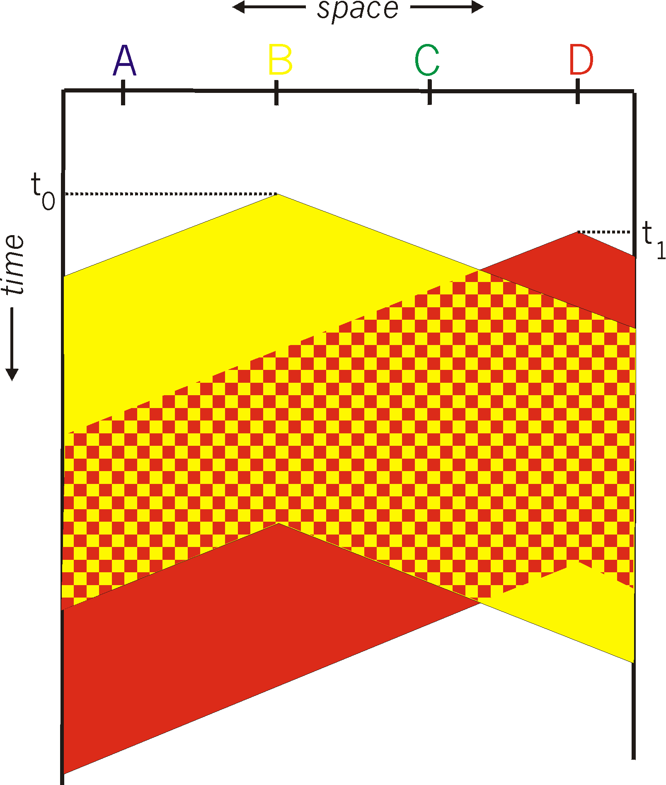
COMPUTER NETWORKS
CSMA : Collisions
spatial layout of nodes
Collisions can still occur with carrier sensing:
Propagation delay means two nodes may not hear each other’s just-started transmission
Collision: entire packet transmission time wasted
Distance & propagation delay play role in in determining collision probability

Slide 12
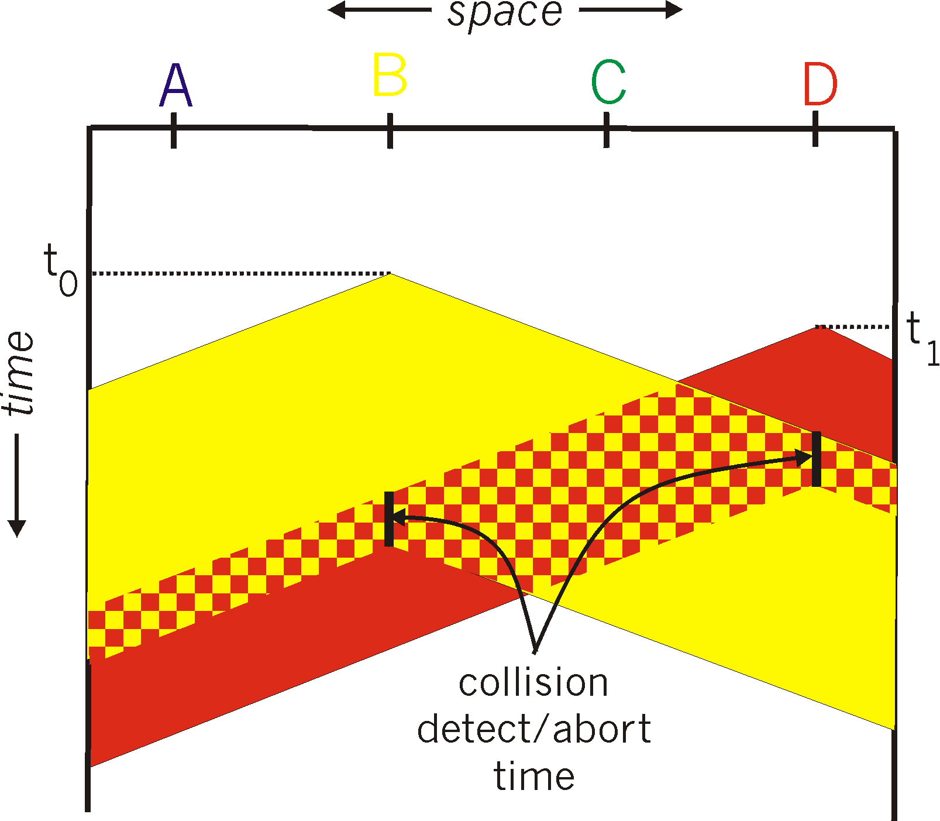
COMPUTER NETWORKS
CSMA / CD
spatial layout of nodes
CSMA/CD reduces the amount of time wasted in collisions
transmission aborted on collision detection

Slide 13
COMPUTER NETWORKS
Ethernet CSMA / CD Algorithm
NIC receives datagram from network layer, creates frame
If NIC senses channel:
if idle: start frame transmission.
if busy: wait until channel idle, then transmit
If NIC transmits entire frame without collision, NIC is done with frame !
If NIC detects another transmission while sending: abort, send jam signal
After aborting, NIC enters binary (exponential) backoff:
after mth collision, NIC chooses K at random from {0,1,2, …, 2^{m}-1}. NIC waits K·512 bit times, returns to Step 2
more collisions: longer backoff interval

Slide 14
COMPUTER NETWORKS
CSMA / CD Efficiency
T_{prop} = max prop delay between 2 nodes in LAN
t_{trans} = time to transmit max-size frame
efficiency goes to 1
as t_{prop} goes to 0
as t_{trans} goes to infinity
better performance than ALOHA: and simple, cheap, decentralized!

Slide 15
THANK YOU
S Nagasundari
Department of Computer Science and Engineering
nagasundaris@pes.edu

